Slide 1
Website Renewal Proposal for Technology Support Professional Program
Team LiftOff
14 January 2014
Notes:
PRESENTATION TASKS
A. HAVE GOOGLE HANG-OUT TOMORROW TO CHOOSE PRESENTATION ROLE,
- OR - CHOOSE/SORT THIS BY SUNDAY NOON.
B. WRITE SCRIPT FOR YOUR SECTION
a) Slide 1 a: Introduce Group (2 MIN MAX) b. Discuss Customer Specifications
c. Use target words to describe proposal - 'functional," etc.
b) Slide 2: Discuss Proposed Navigation (5 MIN MAX) a. Analyse/Discuss Key "As Is" Website Issues
b. Using "Functionality" focus, discuss New Navigation plan c) Slide 3: Discuss 4 designs (5 MIN MAX)
a. 4 designs: Fun, Sophisticate, Stainless Steel, Hero
- Put desktop design as main image for each group (easier to read and discuss) b. Discuss Pros & Cons d) Slide 4: Close (2 MIN MAX) a. 3 key takeaways for client.
b. List and discuss
(3 MIN LEFT OUT AS INSURANCE...WE HAVE 15 MIN MAX ! )
* * * * POWERPOINT NOTES - bullets ONLY
- learn the material, do not read off the slide
Slide 1 - Team & As Is User Case Slide 2 - As Is navigation slides to bottom (for comparison) - Proposed Navigation fadeIn - outline new navigation Slide 3 - 4 mockups (each separately has fadeIn with click) Slide 4 ('the close")
- 3 key points

Slide 2
Today’s discussion
Team
As-Is User Case
Proposed & Revised Navigation
Live Demo
Summary

Slide 3
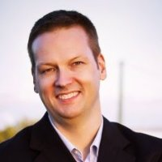
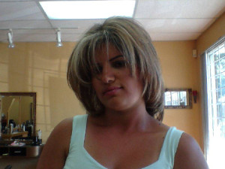
Team
David Huer
Angineh Matousian
Kieran Utz
Sunki Baek

Slide 4
As-Is User Case
Current website provides information but not user friendly
Not representing TSP’s characteristics
Confusing navigation
Schedule: hard to find information

Slide 5
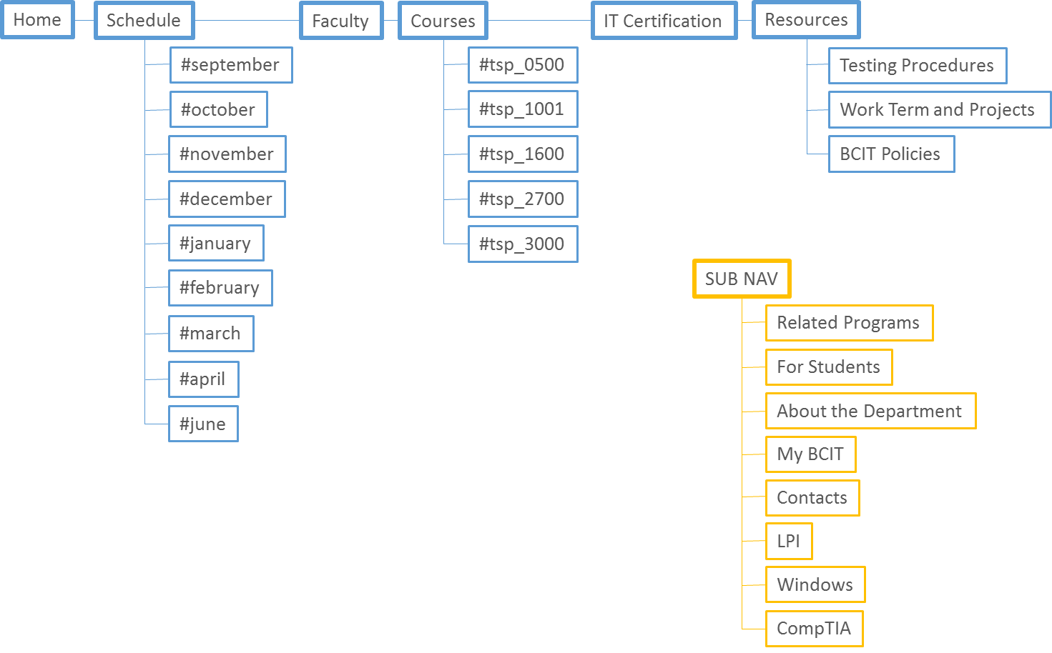
Information Architecture: current
current

Slide 6
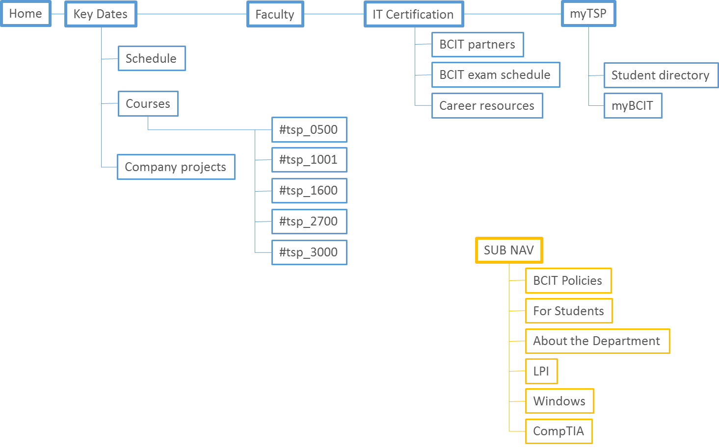
Information Architecture: proposal
proposal

Slide 7
Information Architecture: revised
Home
Schedule
Faculty
Course
Resources
IT Certification
#september
#tsp_0500
Testing Procedures
#october
#tsp_1001
Work Term & Projects
#november
#tsp_1600
BCIT Policies
#december
#tsp_2700
#january
#tsp_3000
#february
#march
#april
Separate Website
#june
CMS Dbase Update

Slide 8
Design E: Scroll
Overall concept
Modern and simple
Layout
Multi-page
Typography
Forte: handwriting style
Colors
Main colors
WHITE/BLACK
SLATE
GREY

Slide 9
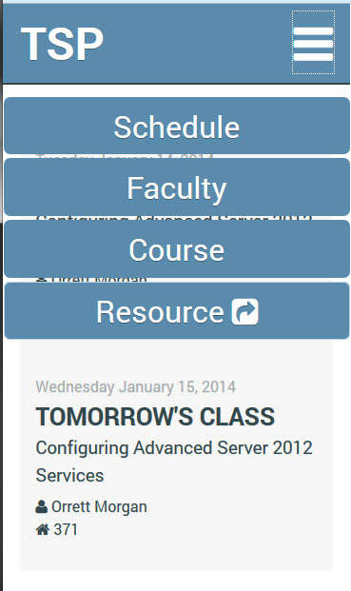
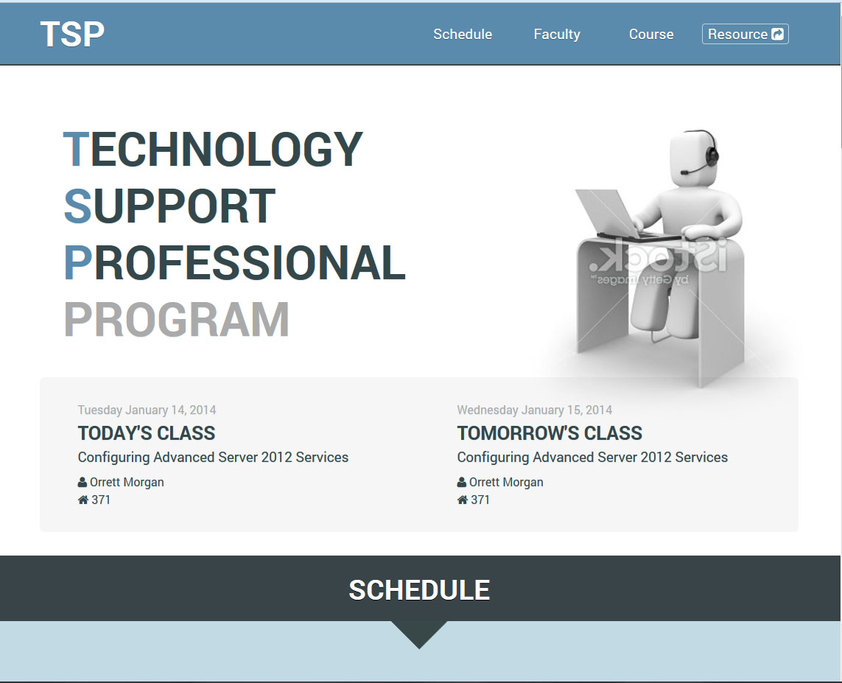
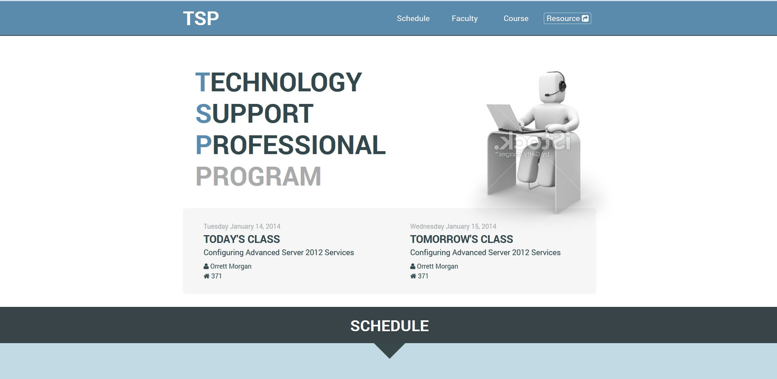
Fits common device sizes

Slide 10
Navigation: clean, current, stylish
DISPLAY MANAGEMENT
One continuous, scrolling series of pages
Highly responsive to multiple devices
Highly adaptable for program changes
Separate Dbase Changes Update page

Slide 11
Dbase Updates: Customer-friendly
DATA MANAGEMENT
Separate page to update database
Highly adaptable, user-friendly
PHP/MySQL back-end
Linked to BCIT dbase
Turn-key: ready to go live

Slide 12
Website Live Demo

Slide 13
Summary
Pages organized as single, scrolling website
User-centric Information Architecture
Highly responsive, Highly adaptable
Scheduling Page – High functionality
Colours, tone, and format match spec
Database Update Website

